Slide 1
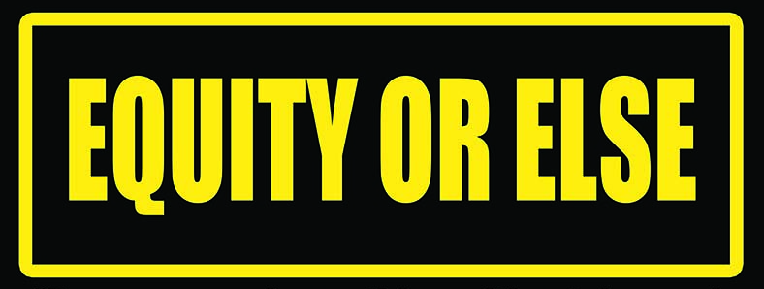
GRASSROOTS VOICES LISTENING PROJECTS

Slide 2
What is the Equity or Else Campaign?
J4J launched the Equity or Else Campaign on May 17, 2021 with a national virtual rally that was viewed by over 3000 people. We brought together leaders and organizers from different quality of life areas (education, housing, health care, environment/climate justice, youth investment and food production and delivery) to share how in-equity impacts these areas and the grassroots solutions they have organized.
We have partnered with organizations such the Center for Popular Democracy, Alliance for Education Justice (youth), Alliance to Reclaim our Schools, Dignity in Schools Coalition, National Alliance Against Racism and Political Repression and several local organizations.

Slide 3
NEXT STEPS FOR EQUITY OR ELSE CAMPAIGN
Hire two organizers to continue to build our base in the south and among youth organizations
We will organize multiple listening projects in no fewer than 50 city across the United States, getting grassroots voices on the harm racism has caused in quality of life areas such as education, housing, safety, climate and youth investment; and what solutions should look like. These listening projects will be in person and virtual. We have organized a national cadre of elected officials, from school board members to U.S. senators to attend the listening projects and organize them in their own district. This is critical, because hundreds of billions of dollars will be flowing into American cities to supposedly address racism and recovery from the COVID pandemic. Without grassroots demand, these resources will not go to our communities.
After the listening projects, we will host regional in person town halls in April of 2022 to develop regional quality of life platforms and bring everyone together at the
J4J National Conference in May of 2022 in Baltimore where we will build our national quality of life platform.
This will culminate with a September 2022 Demand for Equity in Washington DC.

Slide 4
CAMPAIGN GOALS
Develop a national quality of life network with a regional structure
Build national and local quality of life coalition(s) that eliminate the silos that limit our effectiveness and 3) win local and national policy victories centered around equity in quality of life areas that are infected by racism.

Slide 5
Why Listening Projects?
Inequity Poisons Every Quality-of-Life Institution that Impacts Black, Brown and Indigenous People:
Education, Housing, Health Care, Safety, Food, Youth, Environment, Etc.

Slide 6
Goals of the Listening Projects
Effectively document how structural and institutional racism impacts quality of life institutions in Black, Brown and Indigenous communities.
Unify the voices of an emerging national organizing network that is working to address institutional racism that informs local and national policy.
Collect authentic stories (qualitative evidence) to align peer-reviewed research (quantitative evidence) strengthening the demand for community-driven investments in our basic quality of life institutions.
To pressure local and federal decision makers to support our equity-based, quality of life agenda.

Slide 7
HELPFUL HINTS
1. Establish code of conduct in the beginning
2. Strong facilitation is key! You want to give people voice, but FRAME the conversation
3. People directly impacted by racism are the core audience
4. People must speak to their lived experience, not their opinions
5. Give people no longer than 4 minutes to speak
6. Encourage people to submit written testimony
7. You must have official documentarians for the listening project (photographs, notes, video)
8. In listening projects, there is NO DEBATE!

Slide 8
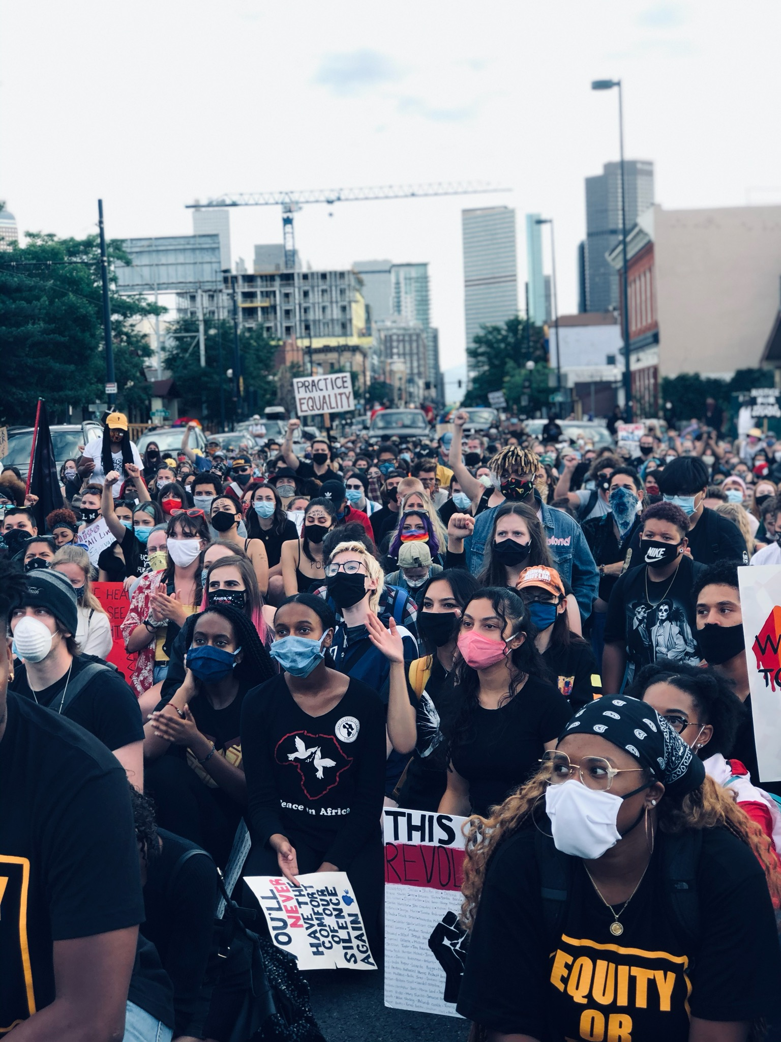
NEXT STEPS
With our collective strength, we can organize listening projects in no fewer than 50 cities across the U.S over the next year. (bring in local and federal officials to LISTEN AND EXPRESS SUPPORT)
As listening projects accumulate, we will organize regional town halls to build regional platforms. (bring in local and federal officials to LISTEN AND EXPRESS SUPPORT)
At the J4J conference in May of 2022, we will bring everyone together to finalize a national quality of life platform.
Mass mobilization in September of 2022.

